Slide 1

ANALYSING ATTACKER BEHAVIOUR THROUGH HONEYPOT
Group Members
Arpit Subhash (20BCE10083)
Manu Yadav (20BCE10290)
Karan Gyani (20BCE10558)
Sunil Kumar Nishad (20BCE10831)
Supervisor
Dr. G.R. Hemalakshmi

Slide 2
CONTENTS
1. Introduction………………….……………………………………………...3 2. Literature Review and Survey……………..……………………………......7 3. Gaps Identified…………………………...…...….........................................9 4. Proposed Work and Methodology………………………..……….………...10 5. Implementation and Coding…...……………………………….……..…....15 6. Tools and Technology Used…………………………………….………….26 7. Conclusion…………………………………………………….……............27 8. References…………………………………………………….…………….28

Slide 3
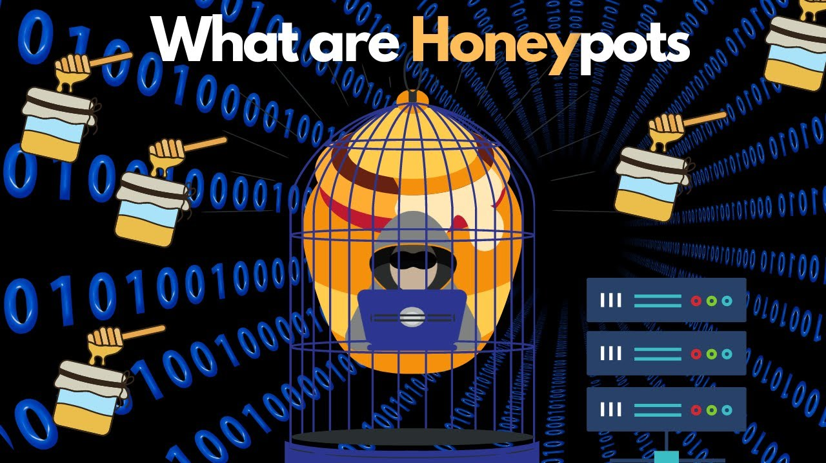
INTRODUCTION
A honeypot is a computer security mechanism set to detect, deflect, counteract attempts at unauthorized use of information systems.
A honeypot consists of data that appears to be a legitimate part of the site, but is actually isolated and monitored, and that seems to contain information of value to attackers, who are then blocked.

Slide 4
Classification of Honeypots
The first classification is based on the role of honeypot-:
According to this classification, honeypots are divided in server-side honeypots and client-side honeypots.
Server-side honeypots are useful in detecting new exploits, collecting malware, and enriching research of the threat analysis.
On the other hand, honeypots for client-side attacks are called client-side. The prime motive of client-side honeypots is to identify and detect malicious activities across the Internet
The second classification is based on the level of interaction-:
The low interaction honeypots detect attackers using software emulation of characteristics of a particular operating system and network services on the host operating system.
Advantage of this approach is in a better control over attacker's activities, since attacker is limited to software running on a host operating system.

Slide 5
Honeynet
The concept of honeypots is extended by honeynets which can be defined as "a highly controlled network of honeypots“. To successfully deploy a honeynet, honeynet architecture needs to be deployed.
There are three core elements of the honeynet architecture that define honeynet architecture
Data capture
Data control
Data collection

Slide 6
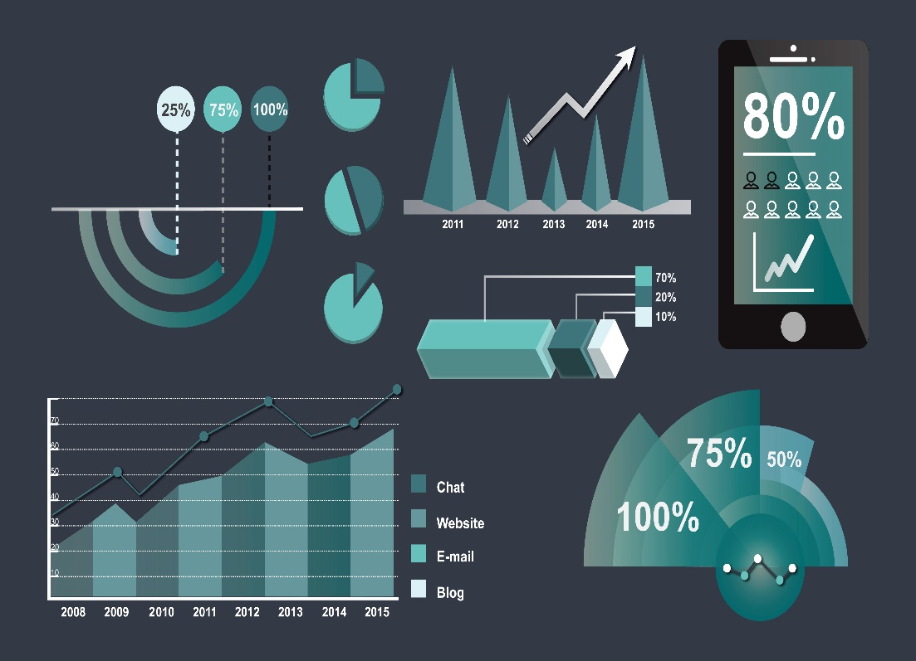
Data Analysis
Data analysis is an ability of honeynet to analyse the data, which is being collected from it Data analysis is used for "understanding, analysing, and tracking the captured probes, attacks or some other malicious activities"

Slide 7
Literature review and survey
Spitzner, L.: The Honeynet Project: Trapping the hackers, in IEEE Security & Privacy, 1(2), pp. 15-23, 2003.
This article details what a honeynet is, how the Honeynet Project works, gives examples of the information collected, and describes a future plan for distributed honeynet deployment.
This paper is earlier referenced by L. Spitzner, Honeypots: Tracking Hackers, Addison-Wesley, 2002; book, where you will gain an understanding of honeypot concepts and architecture, as well as the skills to deploy the best honeypot solutions for your environment.
Sharma, N., Sran, S. S.: Detection of threats in Honeynet using Honeywall, in International Journal on Computer Science and Engineering, 3(10), 3332-3336, 2011.
It focuses on honeywall and how it is used in honeynet environment to trap attackers. One of the modules of honeywall is data analysis module.
Honeywall is a power full tool for capturing attacks in honeynet environment. The information gathering from honeywall would be used in designing an efficient model against malware in computer networks.

Slide 8
Kaur, M. M., Singh, D. Attack Methodology Analysis By Using Honeypot Technology.
It proposes data analysis module in the third generation of honeypots. This module is based on data access method: a relational model based fast path.
This paper presents the deployment of high interaction honeypot in a highly controlled network where every packet entering or leaving is monitored, captured, and analyzed in order to know the attack methodology.
Thonnard, O., Dacier, M.: A framework for attack patterns' discovery in honeynet data, in Digital investigation, 5, pp. 128-S139, 2008.
It proposes the application for analysing one specific aspect of the honeynet data, i.e the time series of the attacks. The result is identification of the activities of several worms and botnets in the traffic according to time series analysis.
The results of our clustering on time series analysis enable us to identify the activities of several worms and botnets in the collected traffic.
Abbasi, F., Harris, R.: Experiences with a Generation III virtual Honeynet, in Telecommunication Networks and Applications Conference (ATNAC), 2009 Australasian, 2009.
This paper proposes a methodology for establishing a virtual Honeynet on a VMware Server running Honeywall CDROM Roo. The implementation is specific to a Linux based host having a single physical network interface card.

Slide 9
Gaps Identified
Honeypots have several risks and disadvantages. Although few in number, it is these disadvantages that prevent honeypots from completely replacing your current security mechanisms.
Limited Vision
Discovery and
Fingerprinting Risk of Takeover

Slide 10




Methodology & Proposed work
DATA
DATA CLEANING AND PREPROCESSING
ANALYSING
PLOTTING

Slide 11
A. DATA
Honeypot data-set used, is taken from AWS honeypot database. It is an open-source database including information on cyber attacks and attempts. Dataset has 451,581 data points collected from 9:53pm on 3 march to 5:55am on 8 September 2013. The data has a total of 15 columns and have been displayed in Table 1 below. The first columns contain date, time. The rest of the columns display specific properties of attacker and host such as country of origin of attack, IP address, latitude, longitude and protocol etc.

Slide 12
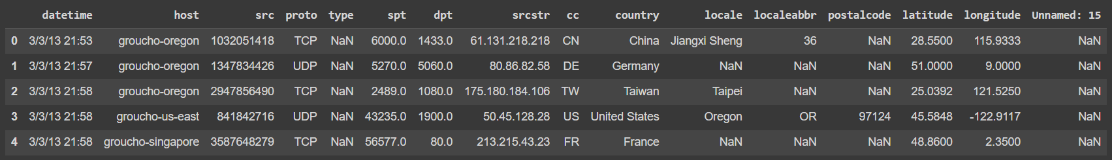
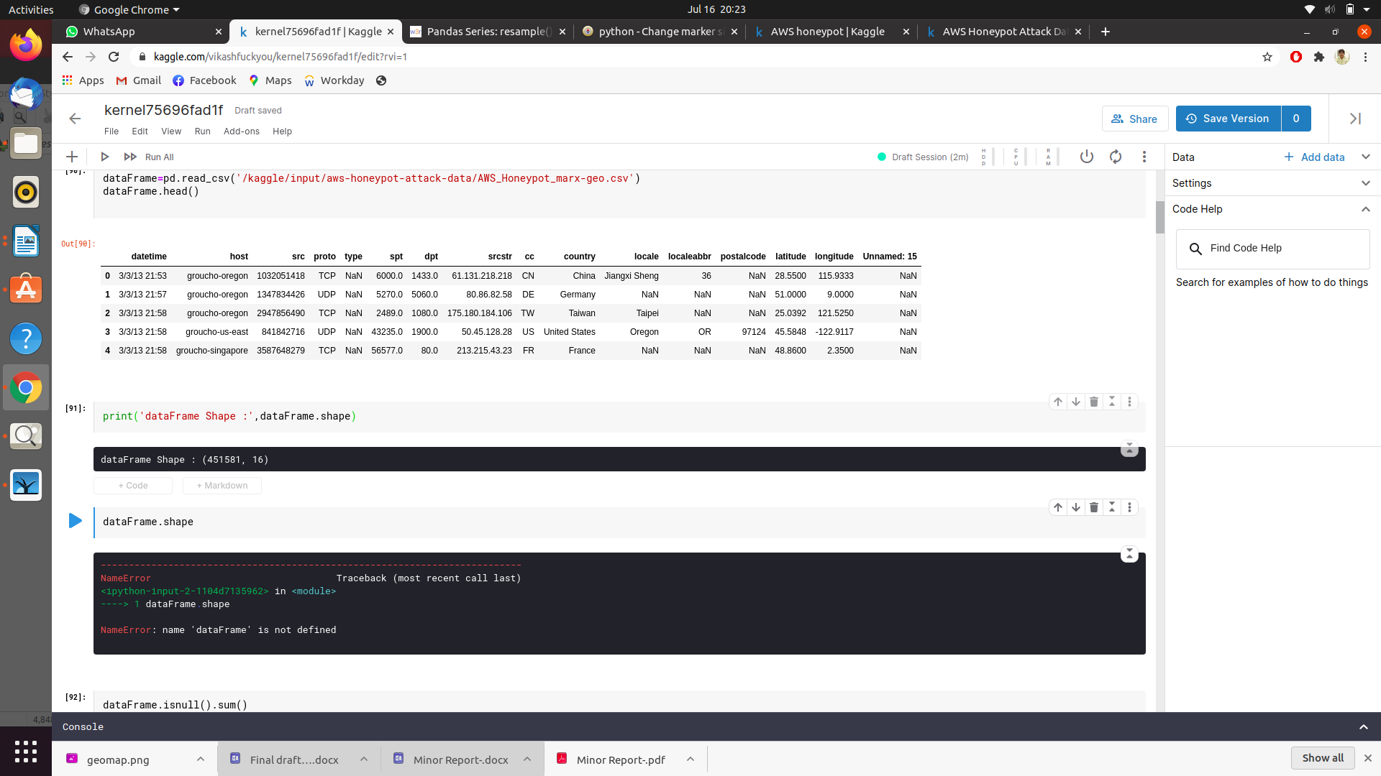
Table 2: Description of Data Set
Table 1: Description of Data Set

Slide 13
B. DATA CLEANING & PREPROCESSING
i) There are several missing values that need to be removed because longitude and latitude are missing, since these are crucial features for the geolocation on world map using geopandas.
ii) There are some faulty values of latitudes and longitudes, as latitude cannot be greater than 90 degrees and cannot be less than -90 degrees. So that need to be dropped from data-set, similarly for longitudes.
iii) There are columns that are not relevant or redundant to project, so that need to be dropped to get better output. Example- “cc”, “src”, “unnamed:15”.
iv) Preprocess datetime using pandas ‘to_datetime()’

Slide 14
C. ANALYSIS
3.1 Geolocation of attacks
3.2 Top 10 countries from attack originate.
3.3 Top 10 host attacked in world.
3.4 Frequency of attack in a hour span
D. PLOTTING
Different plots are plotted using matplotlib, pylot, geopandas.

Slide 15
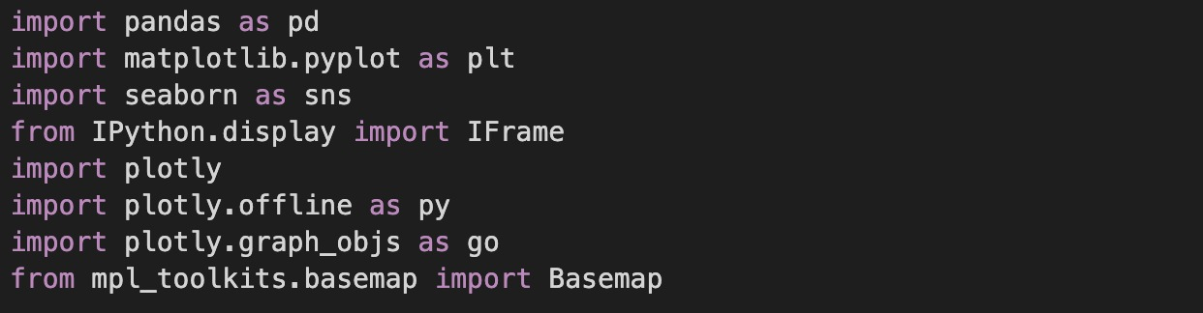
5. IMPLEMENTATION AND CODING
a) Including important libraries:

Slide 16
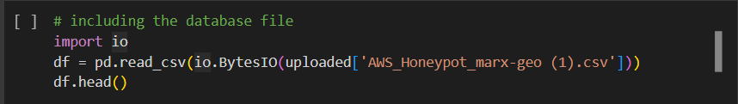
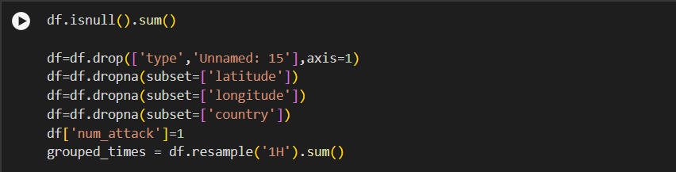
b) Data Cleaning and Preprocessing

Slide 17
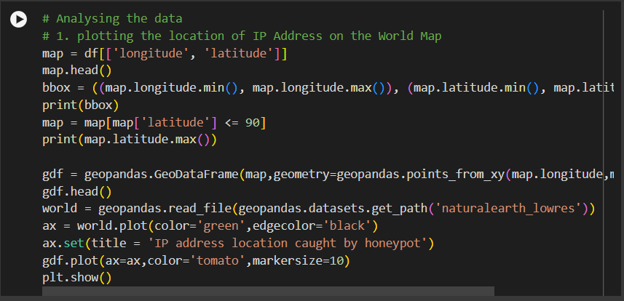
c) Analysing Data
3.1 Plotting location of IP Addresses

Slide 18
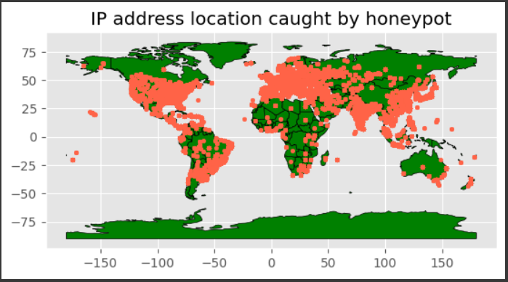

Slide 19
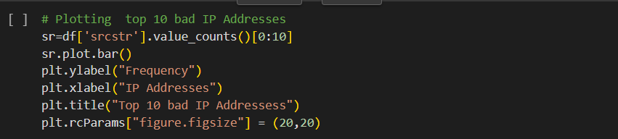
3.2 Plotting top 10 bad IP Adresses

Slide 20
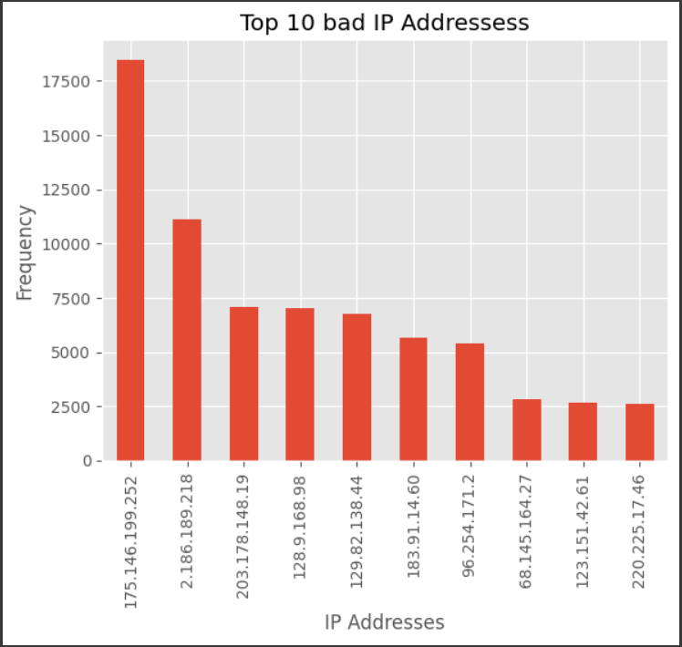

Slide 21
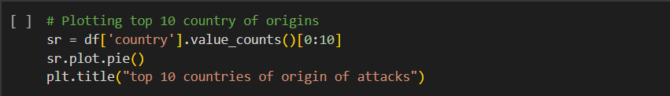
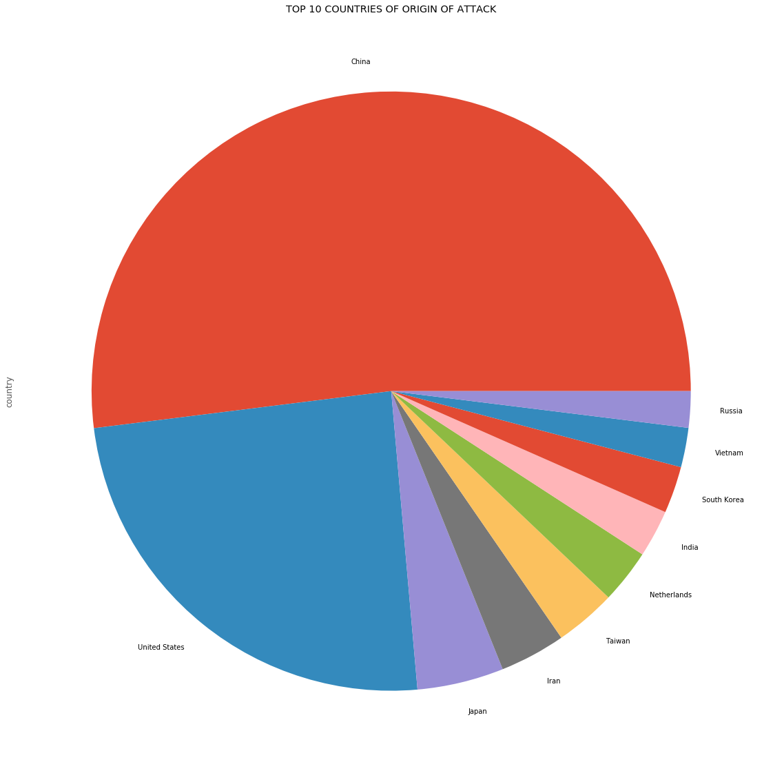

Slide 22
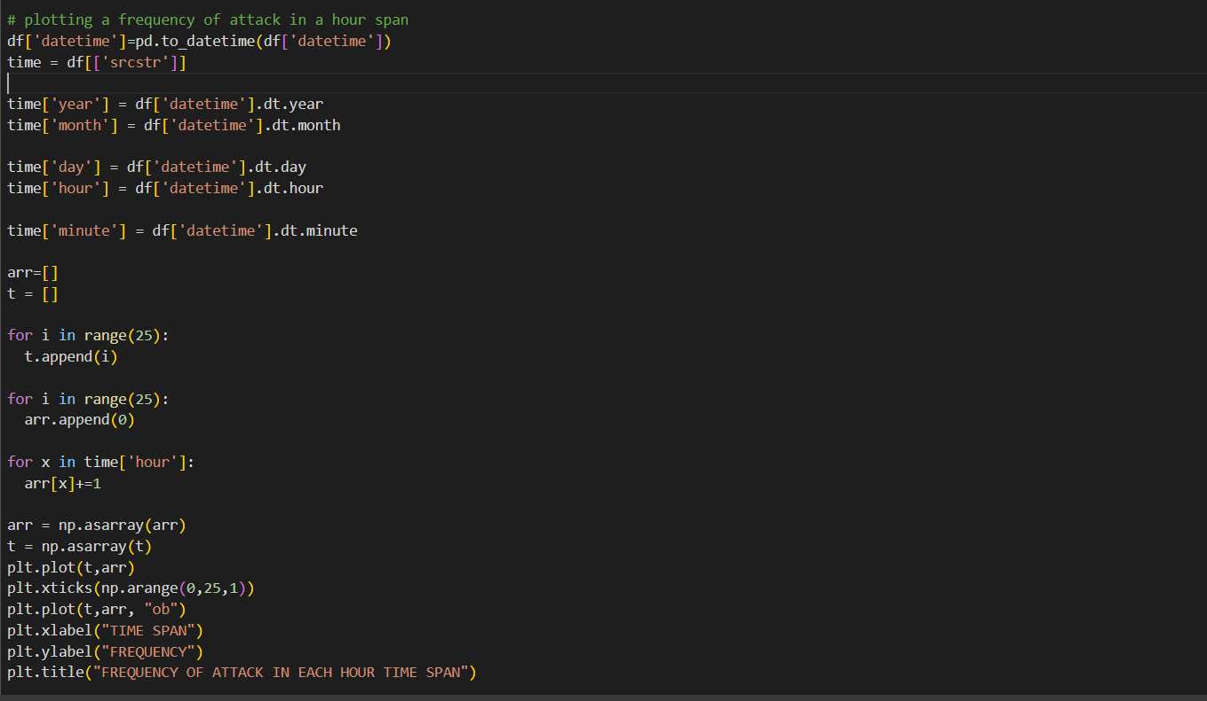
3.4 Plotting frequency of attack in an hour span

Slide 23
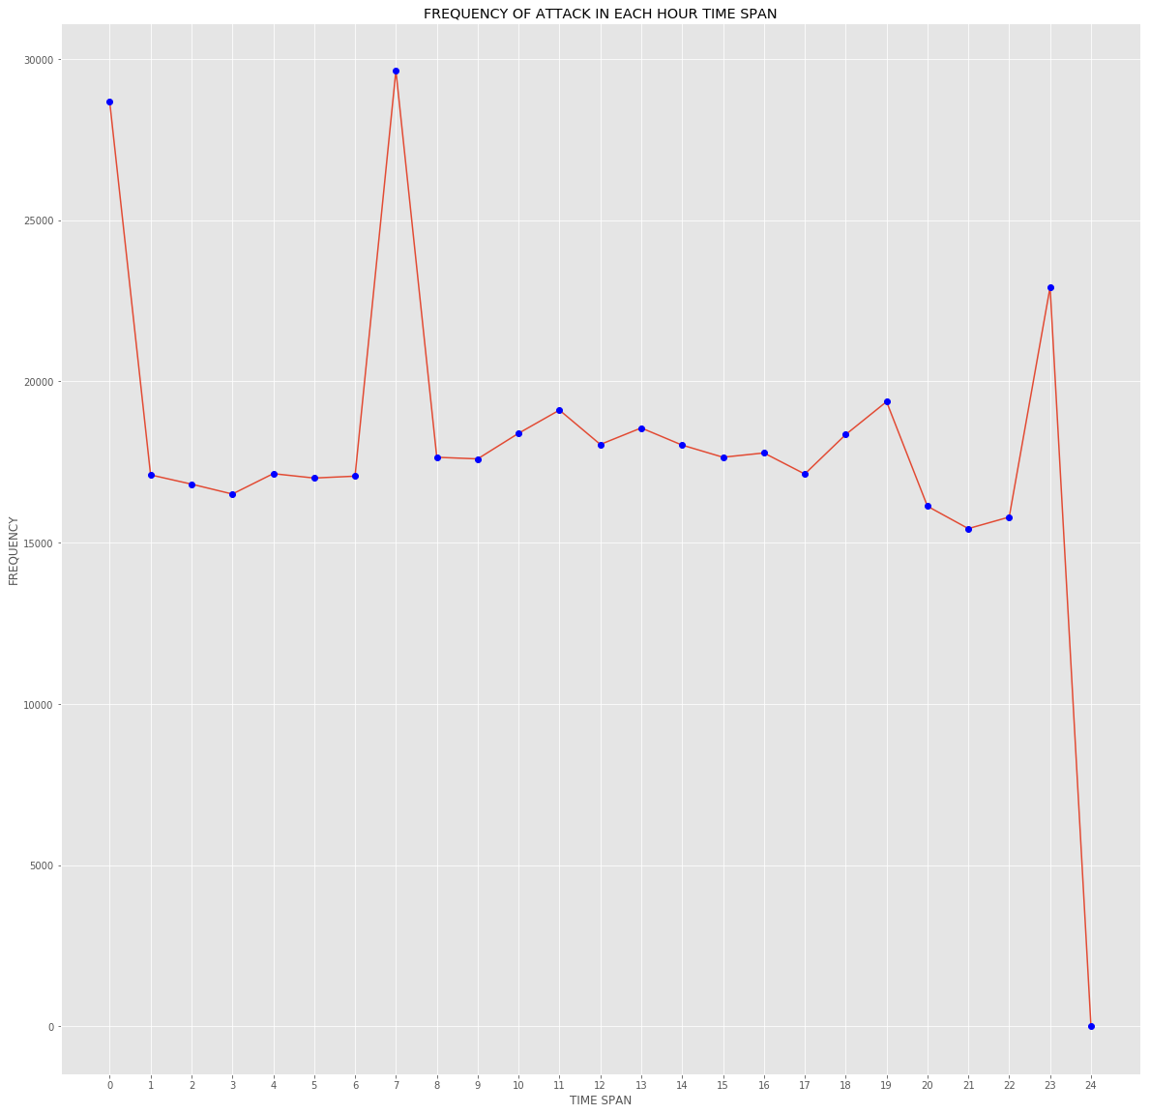

Slide 24
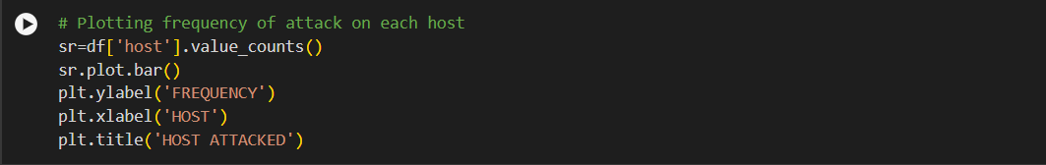
3.5 Plotting frequency of attack on each host

Slide 25
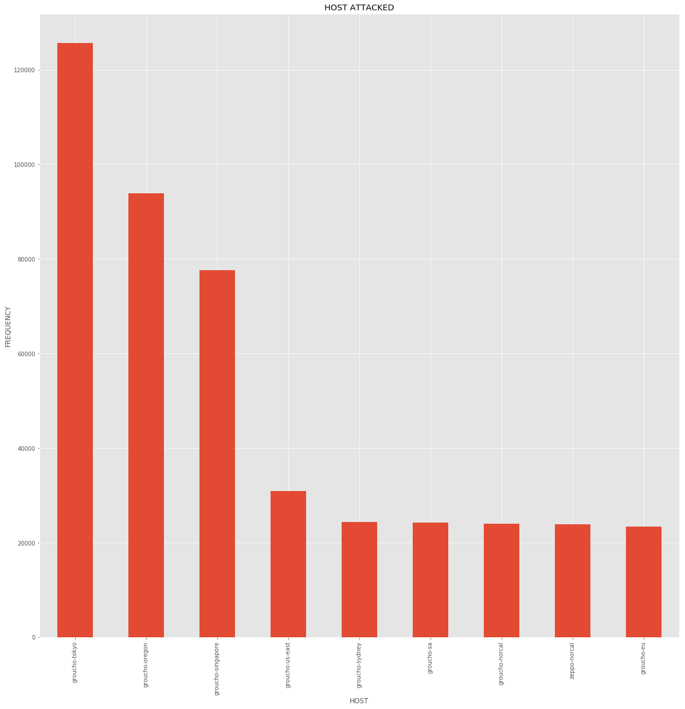

Slide 26
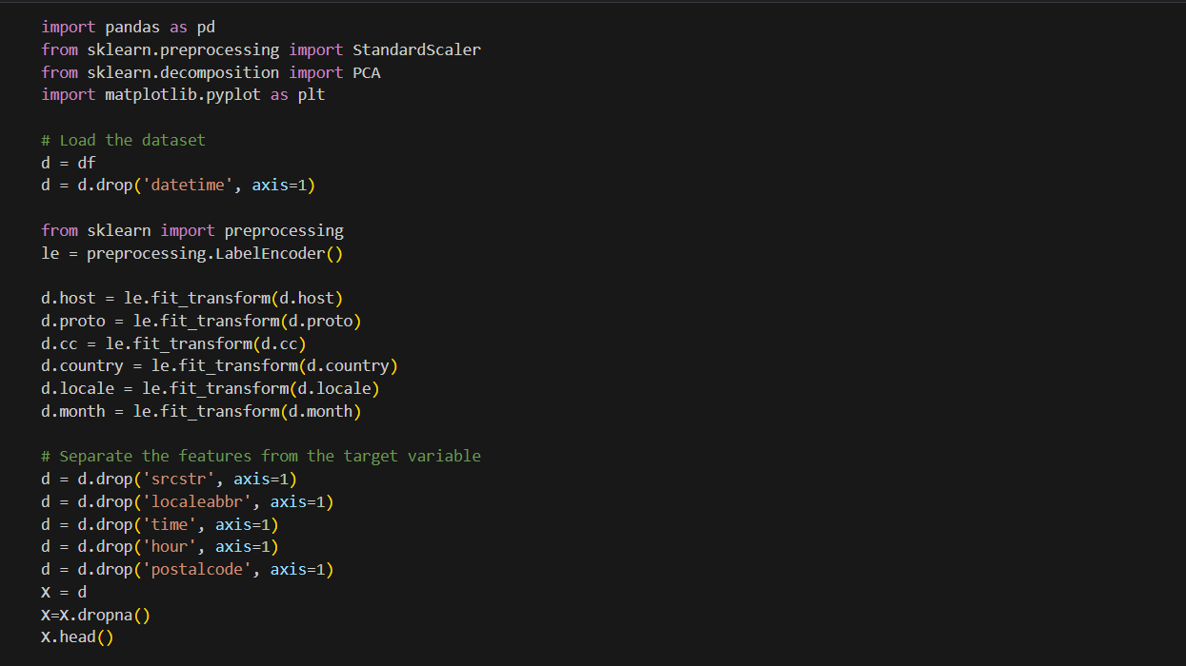
Preprocessing including PCA.

Slide 27
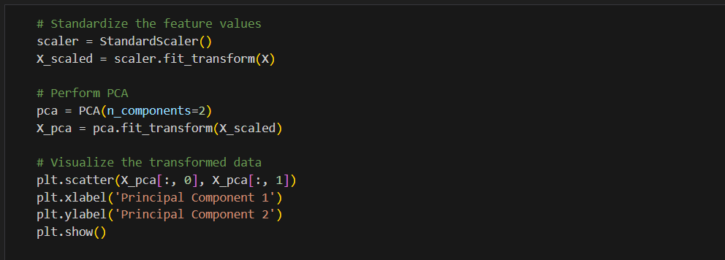

Slide 28
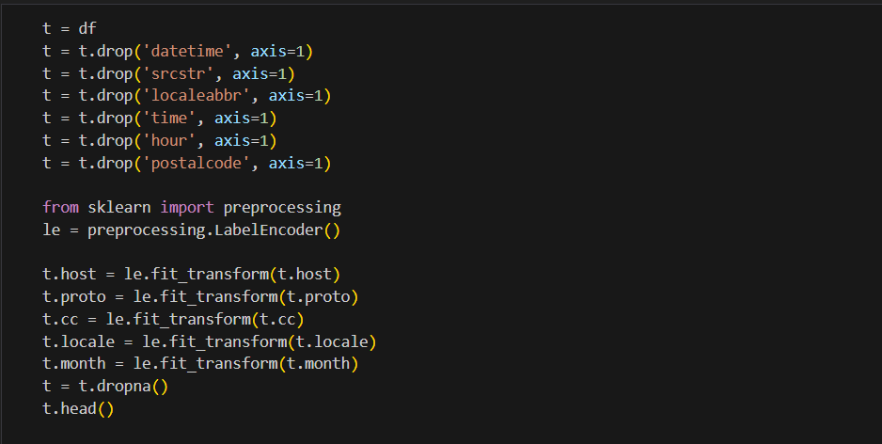

Slide 29
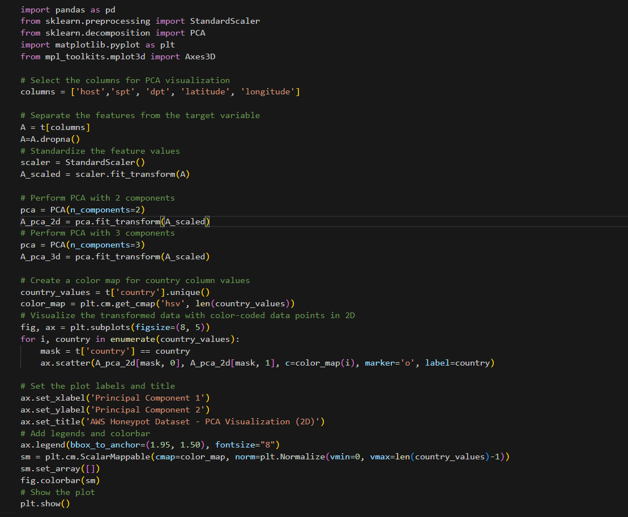
Performing PCA visualization and 3D plot visualization on selected columns, standardizing them, and plotting the transformed data points colored by country values.

Slide 30
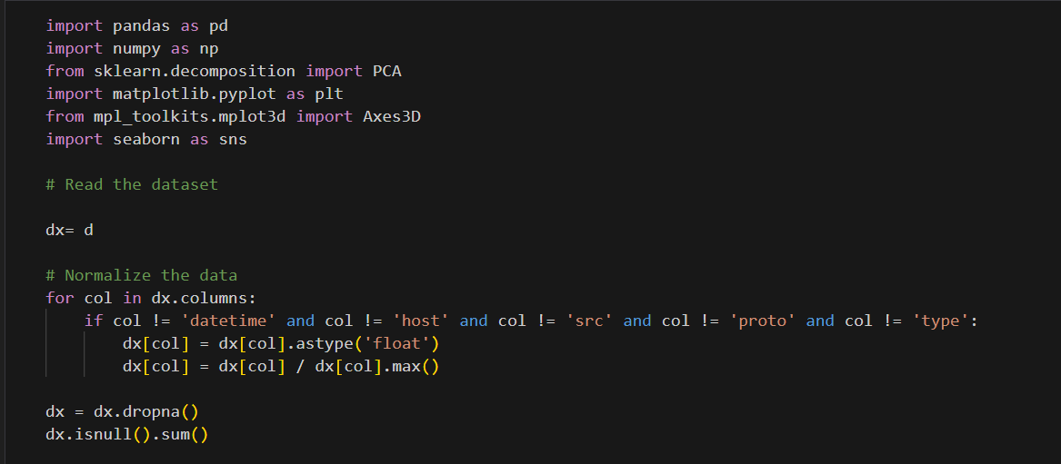

Data normalization is applied to the dataset, excluding specific columns, followed by the removal of rows with missing values, and a subsequent check for any remaining missing values

Slide 31
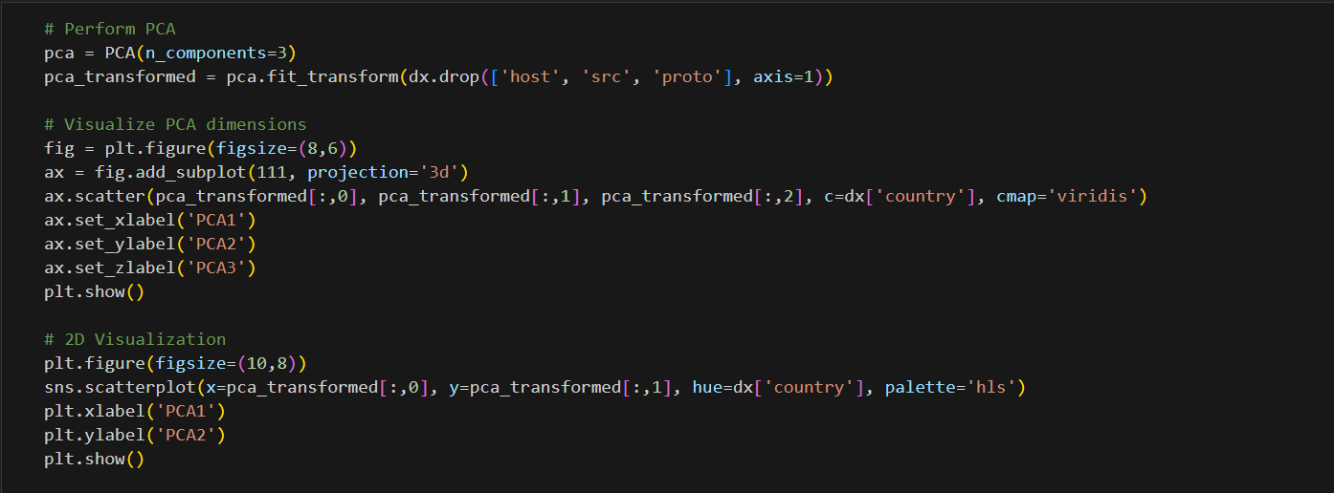
Conducting PCA on the normalized dataset dx, the visualization presents PCA dimensions in both 3D and 2D scatter plots, with colors reflecting country values.

Slide 32
Tools and technology to be used
Software Requirement-:
Jupyter Notebook:
Jupyter Notebook is a powerful scientific environment written in Python, for Python, and designed by and for scientists, engineers and data analysts. It offers a unique combination of the advanced editing, analysis, debugging, and profiling functionality of a comprehensive development tool with the data exploration, interactive execution, deep inspection, and beautiful visualization capabilities of a scientific package. As a development environment, we have used Anaconda Distribution.
Anaconda is an open-source package manager, environment manager, and distribution of the Python language. It is commonly used for large-scale data processing, scientific computing, and predictive analytics. We will use Matplotlib for data visualization, Numpy for various array operations and Pandas for data analysis. We will also use Google Colaboratory to compile the codes from different sources and for data visualization.
Hardware Requirements-:
CPU: 64-bit 2.8 GHz 8.00 GT/s CPUs.
RAM: 4 GB (up to 16 GB of 1600 MHz DDR3 RAM

Slide 33
Possible Outcomes
It discusses different types of honeypots such as production honeypots. It also looked at factors that should be considered while implementing a honeypot. For example, the level of interaction of your honeypot depends on what you want to use it for.
The legal issues surrounding honeypots and their implementation were examined, and throughout it mentioned the advantages of honeypots. Honeypots are a relatively new technology that is becoming increasingly popular, and will become even more so as commercial solutions become available that are easy to use and administer.
The honeypots and honeynets are unconventional tools. Their main purpose is to collect data and subsequently analyse them to learn information about attackers and their methods, tools and objectives. Therefore, it proposes as framework for analysis of data collected from honeypots and honeynets. Because they can be used to collect information on attackers and other threats, it is believed that, they can prove a useful tool in digital forensics investigations.

Slide 34
References
[1] Spitzner, L.: The honeynet project: Trapping the hackers, in IEEE Security & Privacy, 1(2), pp. 15-23, 2003.
[2] Spitzner, L.: Honeypots: Tracking Hackers, in Addison Wesley, pp. 1-430, 2002.
[3] The Conpot Project. 2015: http://conpot.org/
[4] Thug. 2015. http://buffer.github.io/thug/
[5] Biswas, J.: Analysis of Client Honeypots, in International Journal of Computer Science & Information Technologies, 5(4), 2014.
[6] Dionaea. 2015: http://dionaea.carnivore.it/
[7] HoneyD, 2015: http://www.honeyd.org/
[8] Kippo, 2015: https://github.com/desaster/kippo
[9] Joshi, R. C., Sardana, A. (Eds.): Honeypots: A New Paradigm to Information Security, in CRC Press, 2011.
[10] HonSSH, 2015: https://github.com/tnich/honssh/
[11] Abbasi, F., Harris, R.: Experiences with a Generation III virtual Honeynet, in Telecommunication Networks and Applications Conference (ATNAC), 2009 Australasian, 2009.
[12] Kaur, M. M., Singh, D. Attack Methodology Analysis By Using Honeypot Technology.
[13] Sharma, N., Sran, S. S.: Detection of threats in Honeynet using Honeywall, in International Journal on Computer Science and Engineering, 3(10), 33323336, 2011.
[14] Shi-wei, Y., Xiu-shuang, M., & Wei-dong, W. A. N. G.: Core Functions Analysis and Example Deployment of Virtual Honeynet, in Computer Science, 3,021, 2012.
[15] Thonnard, O., Dacier, M.: A framework for attack patterns' discovery in honeynet data, in Digital investigation, 5, pp. 128-S139, 2008.

Slide 35


